Slide 1
Divide and conquer algorithm
First step to go by Joarder ph.d.

Slide 2
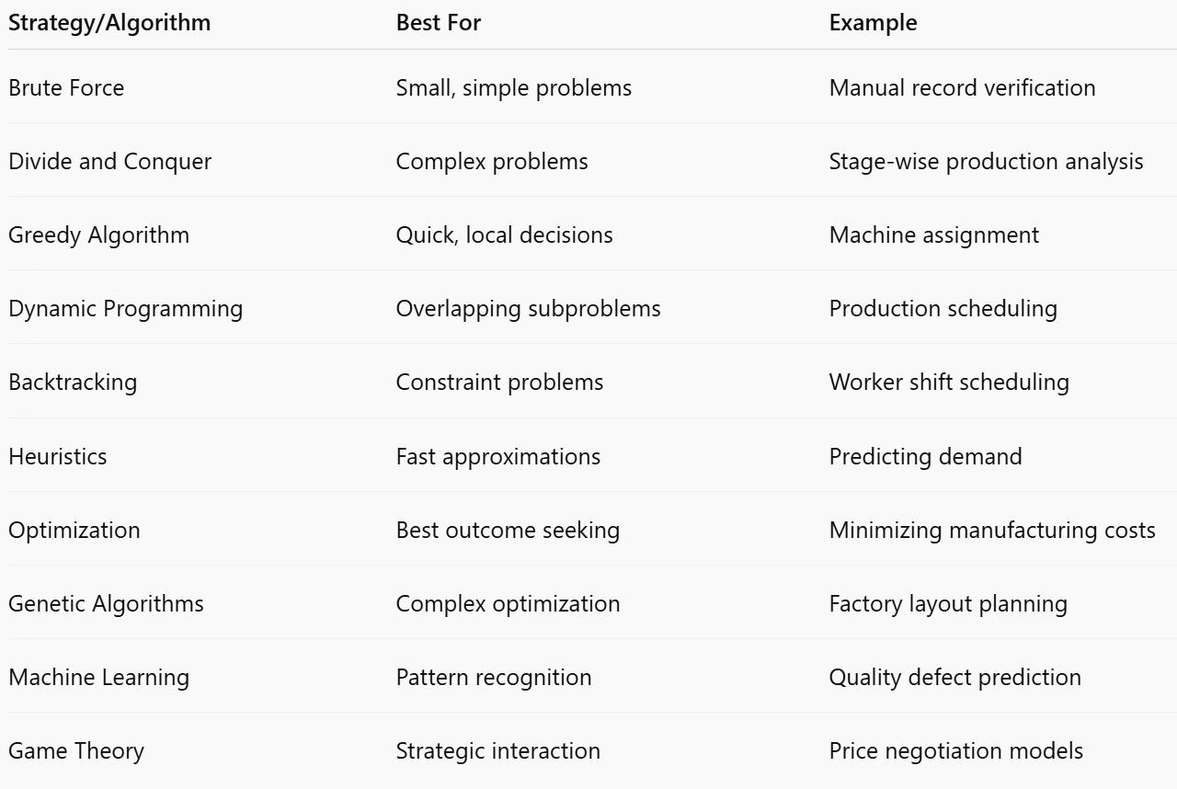
Divide and Conquer
We have various types of Problem-Solving Strategies and Algorithms
Strategy is a design or approach
to solve a problem

Slide 3
1. Brute Force Strategy
Definition: Tries all possible solutions until the correct one is found.
Use: Effective for small problem spaces where exhaustive search is feasible.
Example: Checking all factory records manually for inconsistencies.
2. Divide and Conquer
Definition: Divides a problem into smaller sub-problems, solves each recursively, and combines solutions.
Use: Solving large, complex problems like supply chain optimization.
Example: Analyzing production stages separately before combining the results.

Slide 4
3. Greedy Algorithm
Definition: Makes the locally optimal choice at each step with the hope of finding the global optimum.
Use: Useful for resource allocation problems.
Example: Assigning workers to machines based on immediate availability.
4. Dynamic Programming
Definition: Solves problems by breaking them down into overlapping subproblems and storing their solutions.
Use: Optimizing costs, efficiency, or production scheduling.
Example: Finding the most efficient sequence of manufacturing tasks.

Slide 5
5. Backtracking
Definition: Builds up solutions incrementally and abandons solutions that fail to satisfy constraints.
Use: Decision-making problems where constraints must be respected.
Example: Worker shift scheduling under labor law constraints.
6. Heuristic Methods
Definition: Provides approximate solutions quickly when exact solutions are impractical.
Use: Complex, real-world problems like predicting demand in garment production.
Example: Estimating staffing needs based on historical data trends.

Slide 6
7. Optimization Algorithms
Definition: Focus on finding the best solution according to some criteria.
Examples: Linear Programming, Integer Programming.
Use: Maximizing production output or minimizing cost.
8. Evolutionary Algorithms (Genetic Algorithms)
Definition: Uses mechanisms inspired by biological evolution, like mutation, crossover, and selection.
Use: Solving optimization problems where the solution space is very large.
Example: Designing the most efficient factory layout.

Slide 7
9. Machine Learning Strategies
Definition: Algorithms learn from data and improve over time.
Use: Predictive maintenance, quality control, demand forecasting in RMG.
Examples: Decision Trees, Neural Networks.
10. Game Theory Strategies
Definition: Mathematical modeling of strategic interaction among rational decision-makers.
Use: Negotiating buyer contracts or labor union agreements.
Example: Modeling factory-buyer price negotiations.

Slide 8
Divide and conquer
Definition: Divide and Conquer is an algorithmic paradigm that solves a problem by:
Dividing the problem into smaller subproblems of the same type,
Conquering each subproblem recursively,
Combining their solutions to solve the original problem.
This strategy is highly efficient for problems that can be naturally
broken down into smaller, similar problems.
P size=n
P₁
P₂
P₃
P_{k}
S₁
S₂
S₃
S_{k}
S

Slide 9
Structure of Divide and Conquer
The three key phases of a Divide and Conquer algorithm are:
Divide: Split the problem into smaller parts (usually of equal size or proportion).
Conquer: Solve the subproblems recursively. If the subproblem size becomes small enough, solve it directly
(base case).
Combine: Merge the solutions of subproblems into the solution of the original problem.

Slide 10
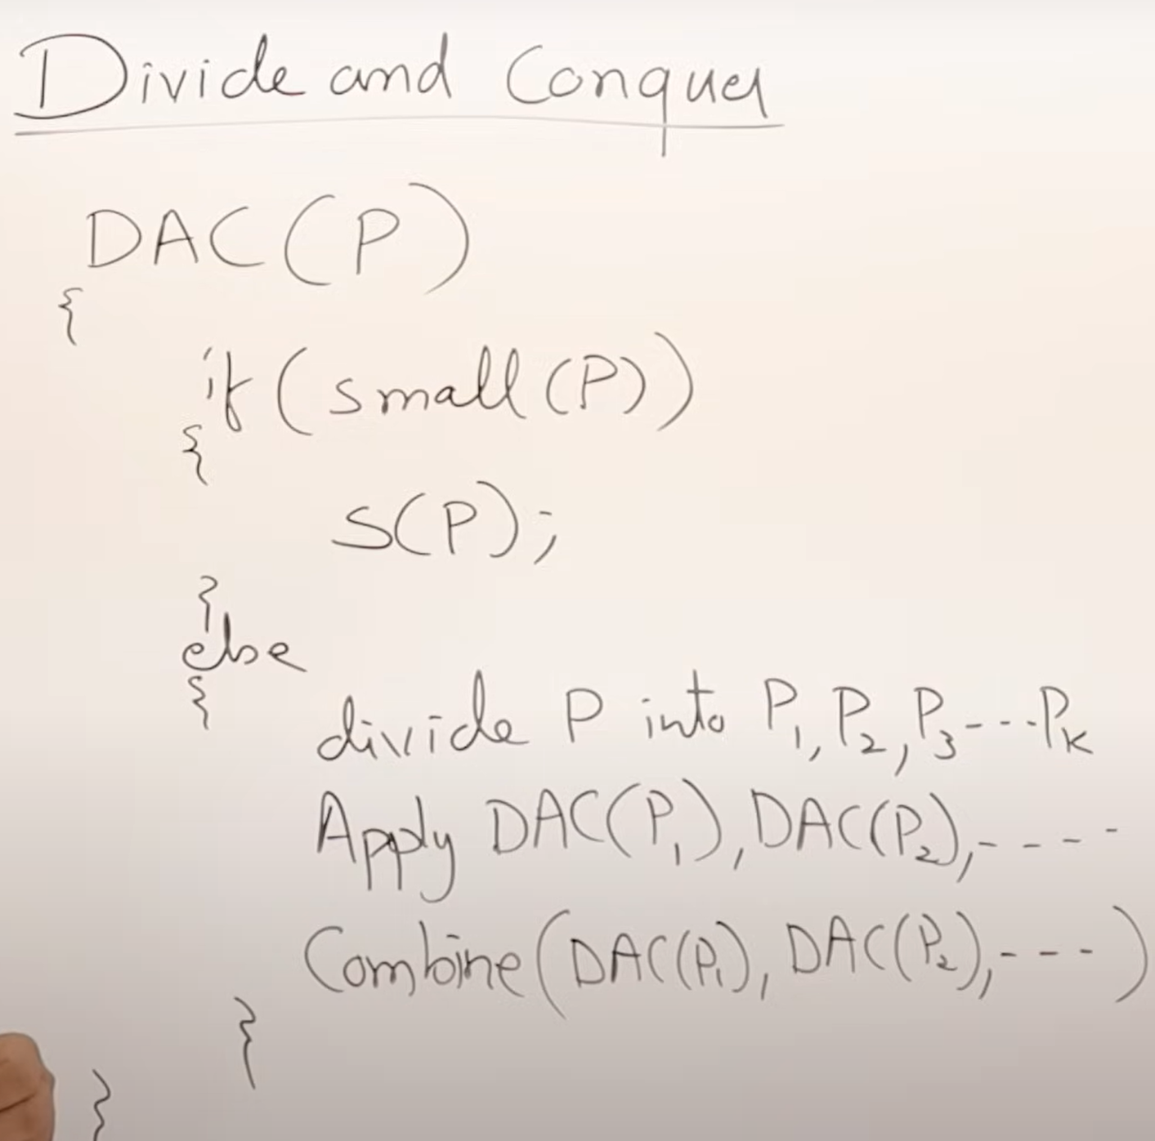

function divideAndConquer(problem):
if (problem is small enough):
solve problem directly
else:
divide problem into subproblems
solve each subproblem recursively
combine solutions of subproblems

Slide 11
Common Examples
Algorithm | Explanation
Merge Sort | Divides array into halves, sorts each half, then merges them.
Quick Sort | Divides array based on pivot, recursively sorts left and right parts.
Binary Search | Divides search space into halves to find an element.
Matrix Multiplication (Strassen's Algorithm) | Divides matrices into sub-matrices and multiplies recursively.

Slide 12
Definition of Recursive Function
A recursive function is a function that calls itself directly or indirectly to solve a problem. It breaks down a problem into smaller instances of the same problem until it reaches a base case, which can be solved without further recursion.
In simple terms, a recursive function solves a big problem by solving smaller and smaller pieces of it — and it keeps calling itself until it finishes.

Slide 13
Key Components of a Recursive Function
Base Case:
The condition that stops further recursion.
Without a base case, recursion would continue indefinitely (leading to errors).
Recursive Case:
The part where the function calls itself to work on a smaller or simpler subproblem.

Slide 14
Simple Examples for Beginners
Example 1: Factorial of a Number
The factorial of a number n (denoted n!) is:
n!=n×(n−1)×(n−2)×⋯×1
Recursive Definition:
Base Case: 0!=1
Recursive Case: n!=n×(n−1)!

Slide 15
Example:
factorial(3) → 3 × factorial(2)
factorial(2) → 2 × factorial(1)
factorial(1) → 1 × factorial(0)
factorial(0) → 1 (base case)
Final result:
3!=3×2×1=6

Slide 16
Quick Visual Summary
Term | Meaning
Recursive Function | A function that calls itself to solve a problem.
Base Case | Stops recursion (simple problem).
Recursive Case | Breaks problem into smaller parts.

Slide 17
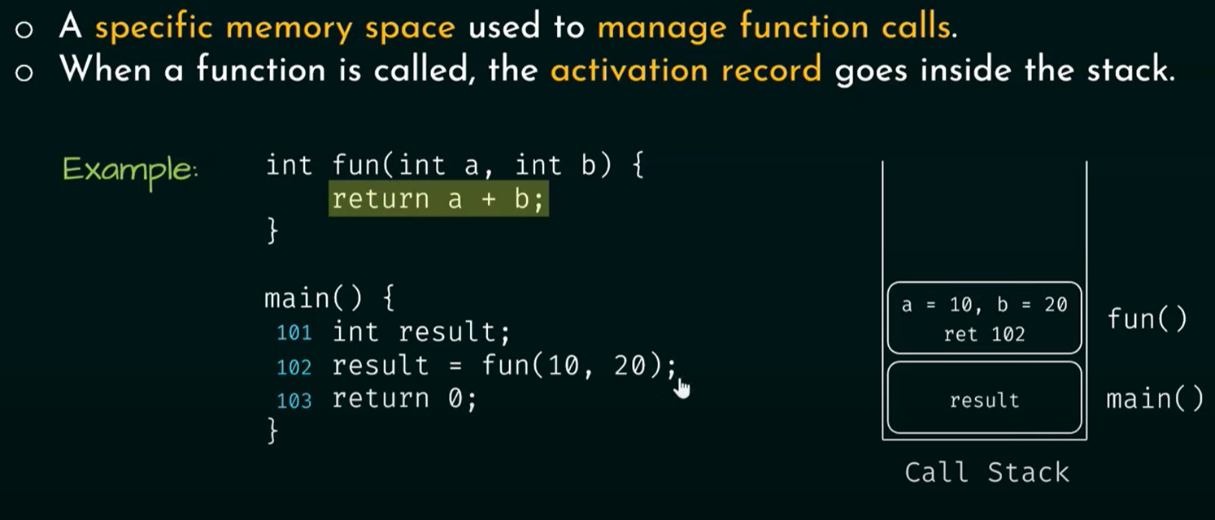
The call stack
Concept | Meaning
Call Stack | Memory structure to keep track of function calls.
Push | Adding a function call to the top of the stack.
Pop | Removing the function call after it completes.
LIFO | Last In, First Out.

Slide 18
Recurrence relation
A recurrence relation is a mathematical equation that defines a sequence recursively, where each term is expressed as a function of its preceding terms.
A recurrence relation is a mathematical expression that defines a sequence or a function in terms of its own earlier values.
In simpler words, it expresses the value of something (like the time it takes to solve a problem) based on smaller versions of the same problem.
It is a foundational tool in mathematics and computer science for modeling recursive structures, algorithms, and sequences.

Slide 19
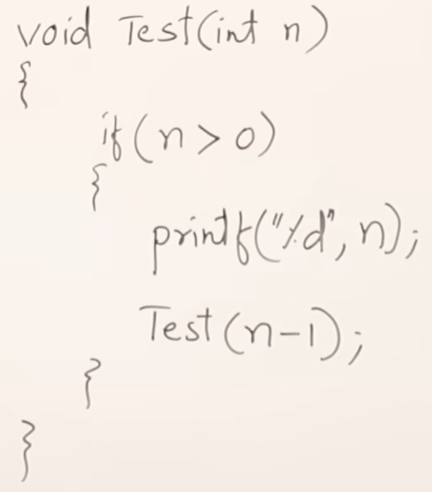
Recurrence relation

Slide 20
TRACING TREE
A tracing tree (or recursion tree) is a visual tool used to map out the sequence of recursive function calls and their outcomes. It helps beginners understand how recursion "unfolds" step-by-step, showing how a problem is broken into smaller subproblems until reaching the base case. Here's a step-by-step explanation:

Slide 21
Let’s trace the recursive factorial function fact(n) using a tree
def fact(n):
if n == 0:
return 1
else:
return n * fact(n-1)
Step 1: Root Node (Initial Call)
Start with the first call: fact(3).
fact(3)
Step 2: Expand the Node
fact(3) calls fact(2), creating a branch:
fact(3)
|
fact(2)
Step 3: Continue Expanding
Repeat until reaching the base case (n=0):
fact(3)
|
fact(2)
|
fact(1)
|
fact(0) → returns 1 (base case)

Slide 22
Step 4: Unwind the Tree (Return Values)
Each node returns its value to the parent:
fact(0) returns 1 → fact(1) computes 1 * 1 = 1.
fact(1) returns 1 → fact(2) computes 2 * 1 = 2.
fact(2) returns 2 → fact(3) computes 3 * 2 = 6.
Final Result: fact(3) = 6.

Slide 23
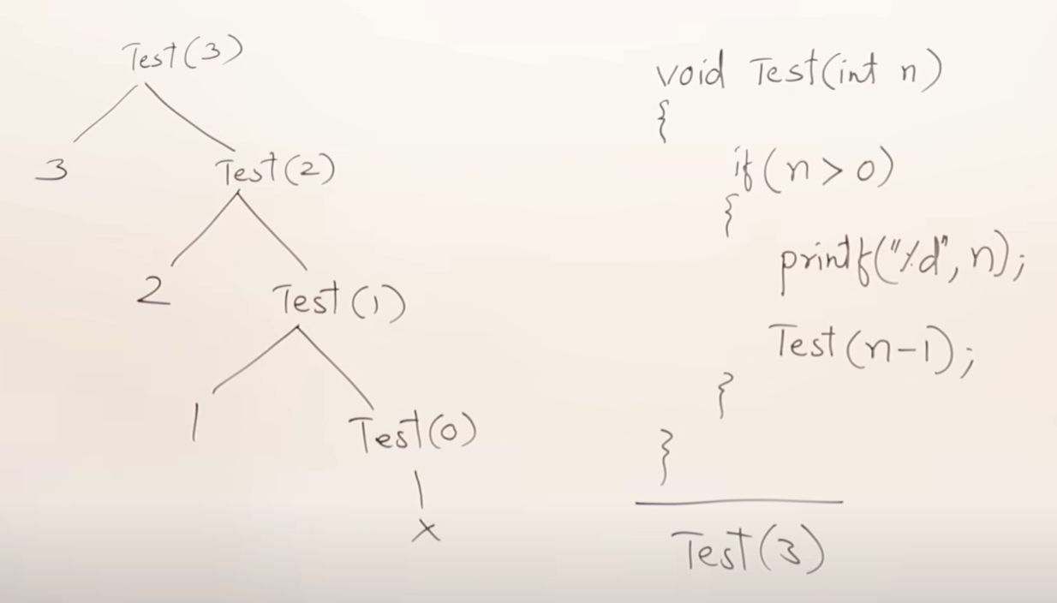
TRACING TREE/
RECURRENCE TREE
f(n)=n+1 calls, Time complexity= O(n)

Slide 24
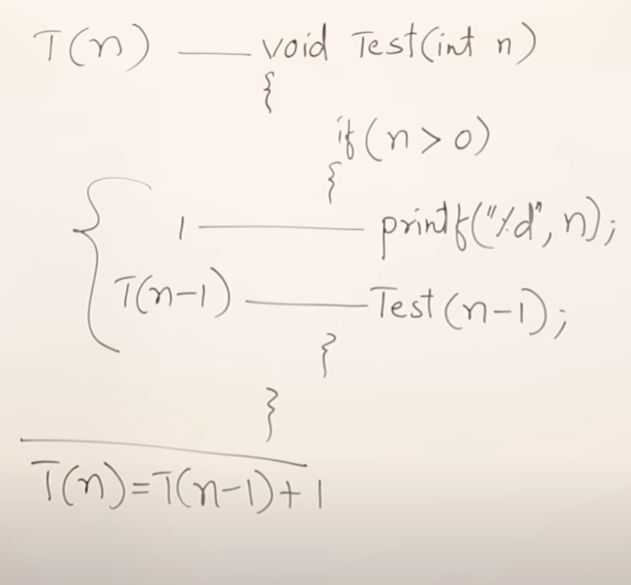
RECURRENCE RELATION
We will solve this problem by
substitute method

Slide 25
Step-by-Step Solution of T(n)=T(n−1)+1
1 n=0
T(n) =
T(n-1)+1 n>0
🛠 Step 1: Expand the recurrence
Start expanding: T(n) = T(n−1)+1
Now expand: T(n−1) = (T(n−2)+1)+1=T(n−2)+2
Expand further: T(n-2) = (T(n−3)+1)+2=T(n−3)+3
Similarly: T(n-3) = (T(n−4)+1)+3=T(n−4)+4
Continue expanding...
After k steps: T(n) =T(n−k)+k
void Test (int n)
{
if (n>0)
{
printf (“%d”, n);
Test(n-1);
}
}

Slide 26
🛠 Step 2: Reach the base case
We keep expanding until n−k=0 . Thus: k=n
Substitute k=n into the expanded form:
T(n) =T(n−k)+k
T(n) =T(0)+ n where T(0) is the time to solve the problem of size = 1+ n (a constant time, we use it as 1).
✅ Thus:
T(n)=O(n) because T(0) is a constant.

Slide 27
void Test (int n) T(n)
{
if (n>0) 1
{
for( i=0; i<n; i++) n+1
{
printf (“%d”, n); n
}
Test(n-1); T(n-1)
}
}
T(n)= T(n-1)+2n+2≈T(n-1)+n
1 n=0
T(n) =
T(n-1)+n n>0

Slide 28
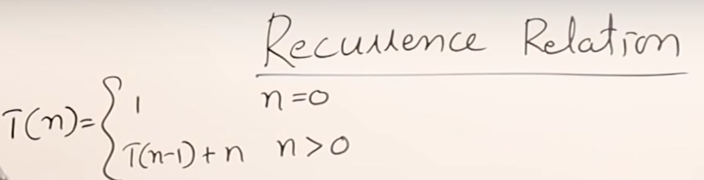
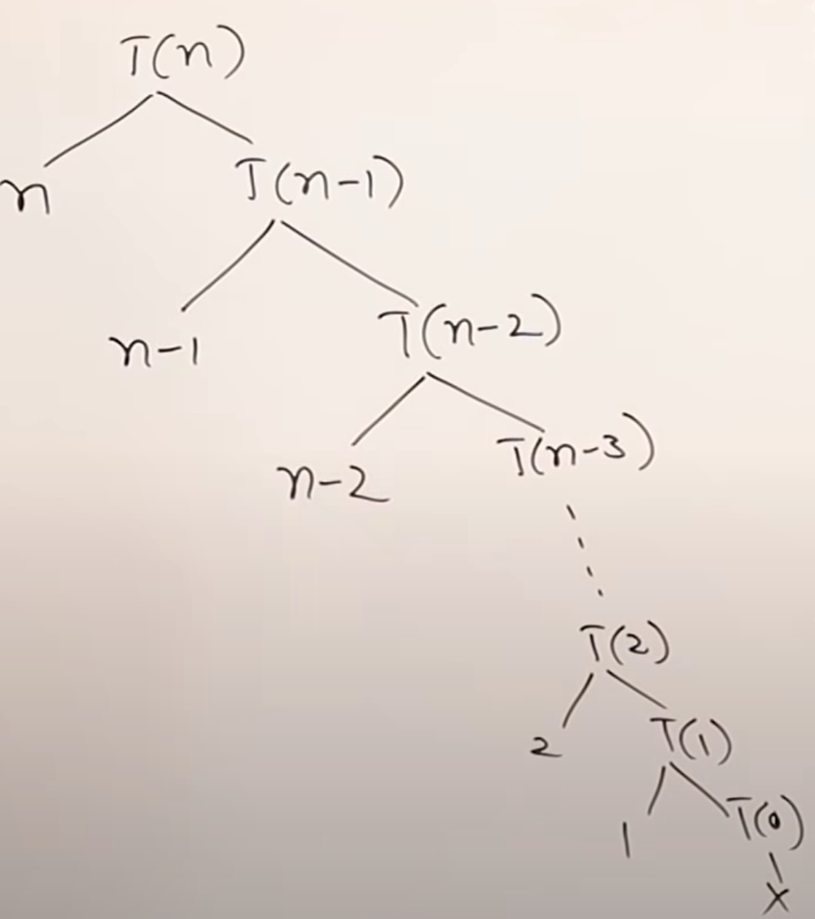
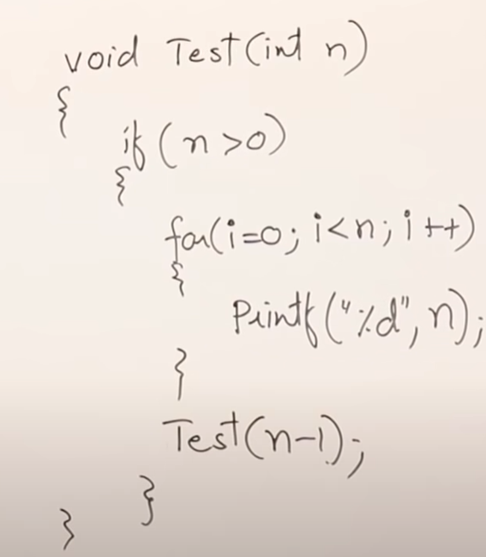

Slide 29
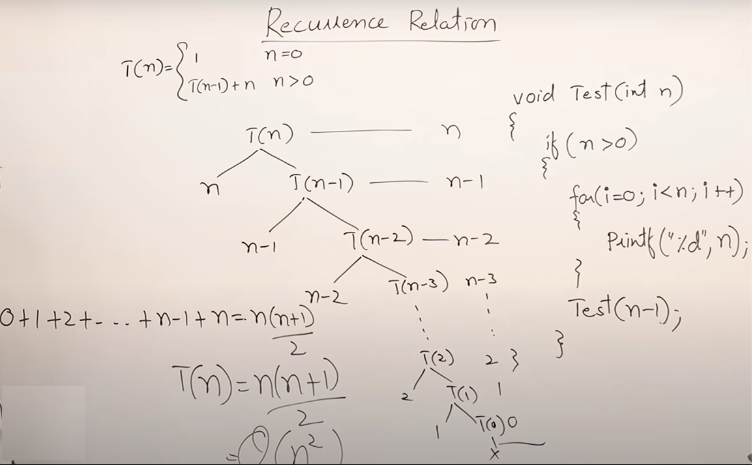

Slide 30
📚 Step-by-Step Solution for T(n)=T(n−1)+n
1 n=0
T(n) =
T(n-1)+n n>0
🛠 Step 1: Expand the recurrence
Expand it manually: T(n)=T(n−1)+n
Expand T(n−1): =(T(n−2)+(n−1))+n
=T(n−2)+(n−1)+n
Expand T(n−2): =(T(n−3)+(n−2))+(n−1)+n
=T(n−3)+(n−2)+(n−1)+n
...
If you keep expanding until the base case, after 𝑛 steps: T(n)=T(0)+1+2+3+⋯+n
(assuming T(0) is a constant, usually O(1)).

Slide 31
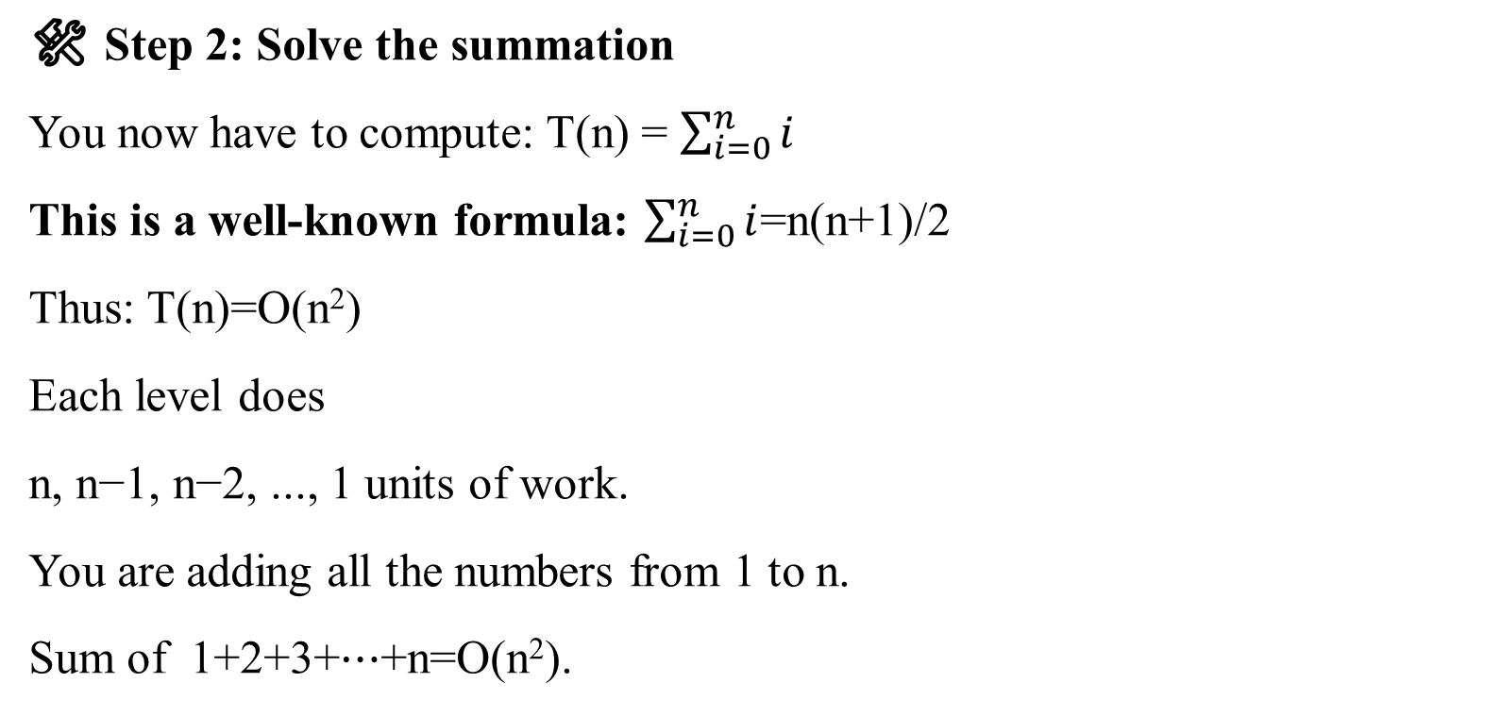
🛠 Step 2: Solve the summation
You now have to compute: T(n) = $\sum_{i=0}^{n}{i}$
This is a well-known formula: $\sum_{i=0}^{n}{i}$=n(n+1)/2
Thus: T(n)=O(n²)
Each level does
n, n−1, n−2, ..., 1 units of work.
You are adding all the numbers from 1 to n.
Sum of 1+2+3+⋯+n=O(n²).
Level 1 (n) → n
Level 2 (n-1) → n-1
Level 3 (n-2) → n-2
...
Level (n-1) (1) → 1

Slide 32
Important Comparisons
Recurrence | Expansion | Final Time
T(n)=T(n−1)+1 | Adding constant 1 at each step | O(n)
T(n)=T(n−1)+n | Adding 1 + 2 + 3 + ... + n | O(n²)
T(n)=T(n−1)+n² | Adding 1² + 2² + 3² + ... + n² | O(n³)

Slide 33
for (i = 1; i < n; i = i * 2) {
// some code
}
Initialization: i=1
Condition: As long as i < n, the loop continues.
Update: Each time, i is multiplied by 2 (i.e., i=2,4,8,16,32,…).
Thus, i grows exponentially, doubling every time.
Let’s find out:
Suppose after k times, i becomes greater than or equal to n.
At each iteration: i=2^{k} We want: 2^{k}≥n
Take logarithm (base 2) on both sides: k ≥ log_{2​}n
Thus, the number of iterations k is proportional to log_{2​}n .

Slide 34
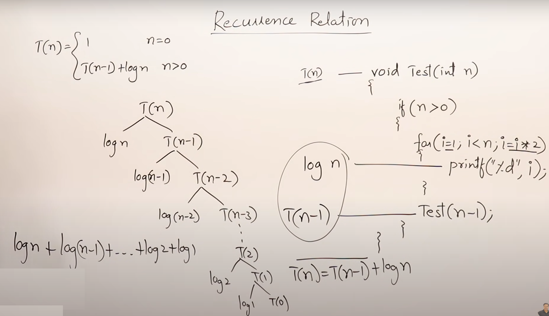


Slide 35
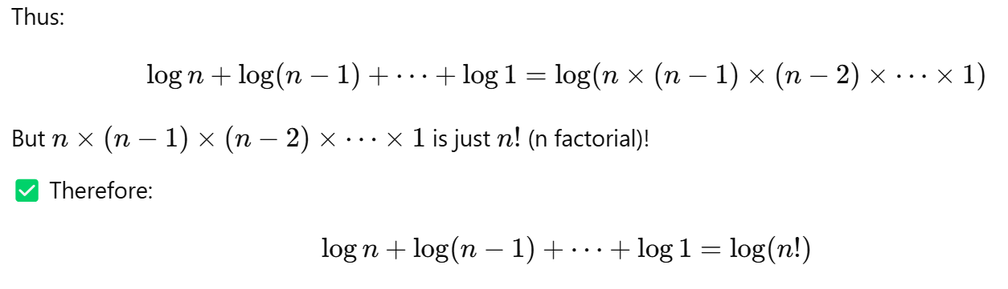
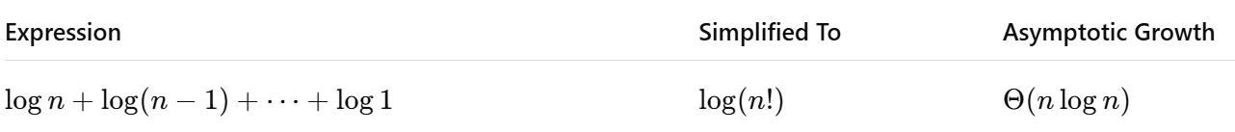
Remember: One important property of logarithms is:
log a+ log b =log(a x b)

Slide 36
📚 Step-by-Step Solution for T(n)=T(n−1)+loG N
void Test (int n) T(n)
{
if (n>0)
{
for (i = 1; i < n; i = i * 2)
{
printf (“%d”, i); log n
}
Test (n-1) (n-1)
}
}
T(n)=(n-1)+log n
🛠 Step 1: Expand the recurrence
Expand it manually: T(n)=T(n−1) + log n
Expand T(n−1):= (T(n−2)+ log (n-1)) + log n=T(n−2)+log(n−1)+log n
Expand T(n−2):=(T(n−3)+log (n-2)) + log (n-1) + log n= T(n−3)+log(n−2)+log(n−1)+log n
...
If you keep expanding until the base case: T(n)=T(0) + log 1 + log 2 + log 3 + … + log n
(assuming T(0) is a constant.)

Slide 37
🛠 Step 2: Solve the summation
log(a x b) = log a + log b [Now, a key property from mathematics]
T(n)=T(0) + log 1 + log 2 + log 3 + … + log n
log (1 x 2 x 3 x…. x n) = log n!
log(n!)≈log(n^{n})=nlogn
Therefore: T(n)=O(n log n)
Level 1 (n) → log n
Level 2 (n-1) → log (n-1)
Level 3 (n-2) → log (n-2)
...
Level (n-1) (1) → log 1

Slide 38
🌟 Important Comparisons
Recurrence | Expansion | Final Time
T(n)=T(n−1)+1 | constant addition | O(n)
T(n)=T(n−1)+n | linear addition | O(n²)
T(n)=T(n−1)+n² | quadratic addition | O(n³)
T(n)=T(n−1)+log n | logarithmic addition | O(n log n)
T(n)=T(n-2)+1 | constant addition | O(n/2)≈O(n)
T(n)=T(n-100)+n | linear addition | O(n²)
T(n)=2T(n-1)+1 | ? | ?

Slide 39
1 n=0
2T(n-1)+1 n>0
void Test (int n) T(n)
{
if (n>0)
{
printf (“%d”, n); 1
Test(n-1); T(n-1)
Test(n-1); T(n-1)
}
}
T(n) = 2T(n-1)+1
T(n) =

Slide 40
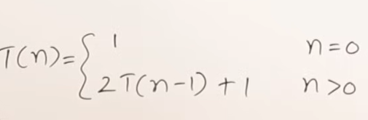

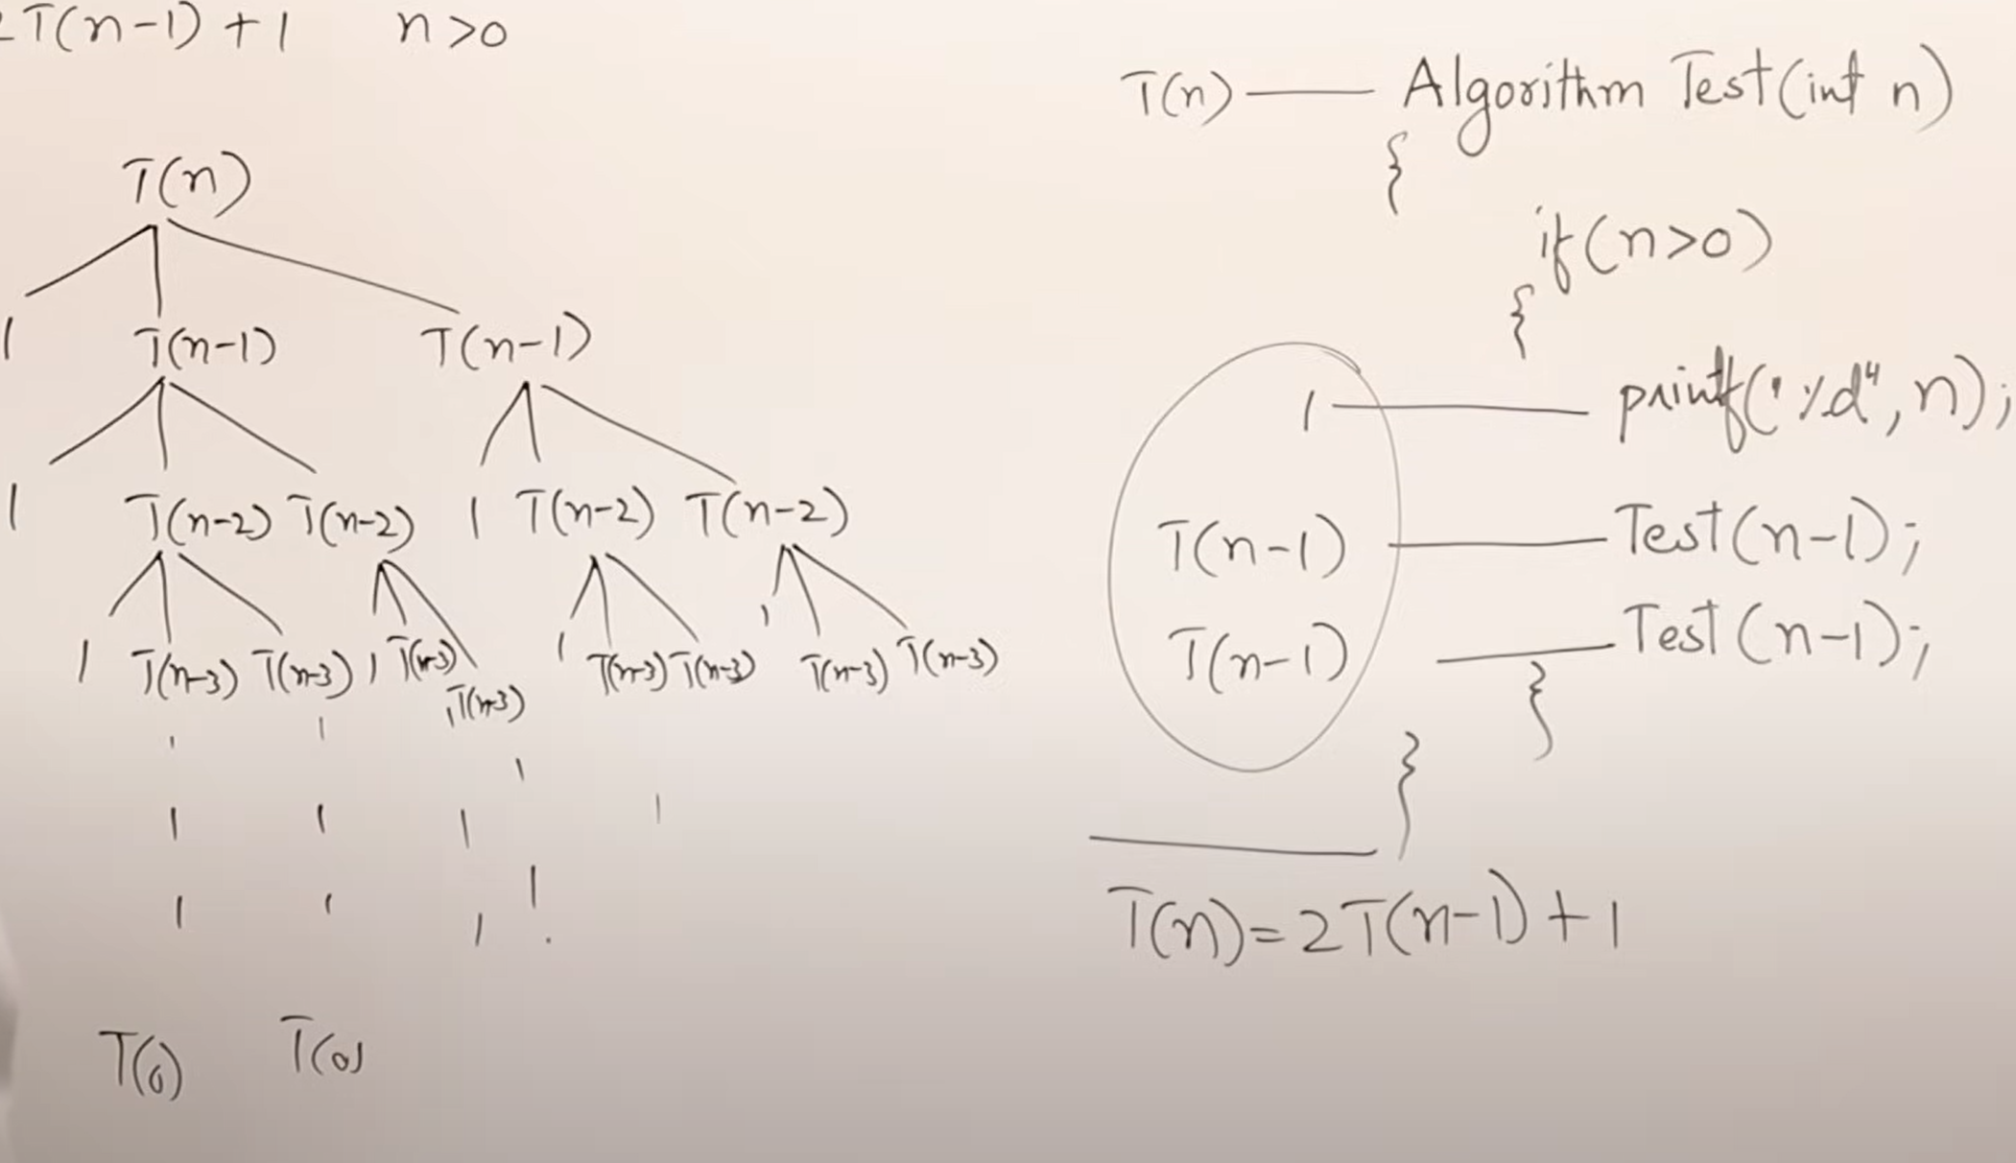




Slide 41
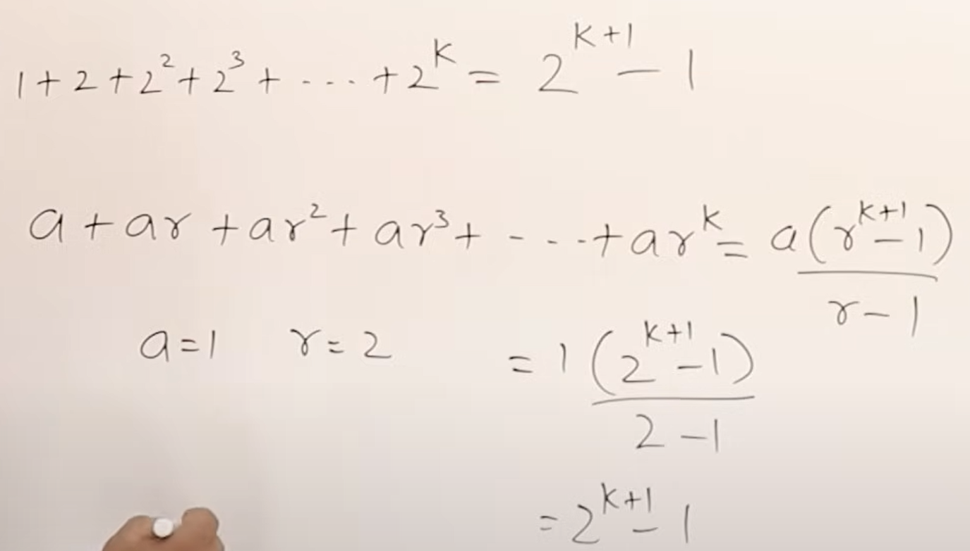



Assume
n-k=0
n=k
O(2^{n})
=2^{n+1}-1=2^{n}

Slide 42
📚 Step-by-Step Solution for T(n)=2T(n−1)+1
🛠 Step 1: Expand the recurrence
Expand manually:
First expansion: T(n) =2T(n−1) +1
Expand: T(n−1) =2(2T(n−2) +1) +1=2²T(n−2) +2×1+1
Expand: T(n−2) =2²(2T(n−3) +1) +2×1+1=2³T(n−3) +2²×1+2×1+1
Expand more: T(n-3) =2⁴T(n−4) +2³×1+2²×1+2×1+1
...
After k steps:
k-1
T(n)=2^{k}T(n−k) + ∑2^{i} i=0

Slide 43
1 n=0
2T(n-1)+1 n>0
T(n) =
🛠 Step 2: Reach the base case
We stop when: n−k=0 ⇒k=n
Thus: n-1
T(n)=2^{k}T(n−k) + ∑2^{i} =2^{n}T(0) + 2^{n} -1 ; Simply T(n)=O(2^{n}) i=0
[T(0) is a constant (say, O(1)).]
It’s a geometric series:
^{n-1}
1+2+2²+2³+⋯+2^{n−1} = ∑2^{i} =2^{n} -1
^{i=0}

Slide 44
Important Comparisons
Recurrence | Expansion Summary | Final Time Complexity
T(n)=T(n−1)+1 | Add 1 each time | O(n)
T(n)=T(n−1)+n | Add 1+2+...+n | O(n²)
T(n)=T(n−1)+log n | Add log1+log2+⋯+logn | O(nlogn)
T(n)=2T(n−1)+1 | Double work each time | O(2^{n})
`T(n)=3T(n−1)+1 | Triple work each time | O(3^{n})
T(n)=2T(n−1)+n | Double previous + n | O(n2^{n})≈O(2^{n})

Slide 45
What is the Decreasing Function Master Theorem?
Applies when the problem size reduces by subtraction (n-b)
Standard form: T(n) = a T(n-b) + f(n)
Used in problems like: Factorial, simple recursion, etc.
🛠 Important Notations:
Symbol | Meaning
a | Number of subproblems generated (could be >1)
b | Size decrease (fixed amount, e.g., 1, 2)
f(n) | Work done outside the recursion
Usually b = 1, a could be 1, 2, 3...

Slide 46
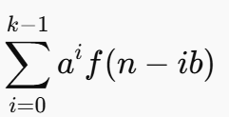
Expansion of the Recurrence
Expand:
T(n) = aT(n-b) + f(n)
= a(aT(n-2b) + f(n-b)) + f(n)
= a²T(n-2b) + a f(n-b) + f(n)
= a³T(n-3b)+a²f(n-2b) + a f(n-b) + f(n)
After k steps:
T(n) = a^{k} T(n-kb) + [sum of work]

Slide 47


Base Case
Stop expansion when n-kb = 0 [(Expansion continues until n−kb hits 0 or becomes small enough — base case)]
Thus: k = n/b ⇒k=O(n) (if b=1)
Final form:
T(n) = a^{(n/b)} * T(0) + Summation of work [ ]
Again:
Standard form: T(n) = a T(n-b) + f(n)
a>0, b>0, f(n)=O(n^{k}) where k>=0
If a=1, O(n^{k+1})⇒O(n*f(n))
T(n)=T(n−1)+1 O(n)
T(n)=T(n−1)+n O(n²)
T(n)=T(n−1)+log n O(nlogn)

Slide 48
T(n)=2T(n−1)+1 O(2^{n}) T(n)=2T(n−2)+1 O(2^{n/2})
T(n)=3T(n−1)+1 O(3^{n})
T(n)=2T(n−1)+n O(n2^{n})≈O(2^{n})
If a>1, O( n^{k} a^{n/b} )
If a<0 , O( n^{k}) ⇒O(f(n))

Slide 49
Three Cases of Master Theorem T(n) = a^{(n/b)} * T(0) + Summation of work [ ]
There are three cases depending on how f(n) behaves compared to a^{k}:
Case 1: f(n) smaller -> O(a^{(n/b)}) [If f(n) grows slower than recursion work]
Then: T(n)=Θ(a^{n/b}) ✅ Recursion dominates.
Case 1: T(n)=2T(n−1)+1, f(n)=1 (small), a=2 Thus: ✅ T(n)=O(2^{n})
Case 2: f(n) same as recursion -> O(a^{(n/b)} * n)
T(n)= 2T(n−1)+n , f(n)=n, a=2, Thus: T(n)=O(n×2^{n})
Case 3: f(n) bigger -> O(Sum of f(n)), T(n)=T(n−1)+n²
f(n)=n² (big compared to recursion with a=1). Thus: ✅ T(n)=O(n³)
(because sum of 1²+2²+⋯+n²=O(n³).

Slide 50
Examples Summary
T(n) = T(n-1) + 1 -> O(n)
T(n) = T(n-1) + n -> O(n²)
T(n) = T(n-1) + log n -> O(n log n)
T(n) = 2T(n-1) + 1 -> O(2^{n})
T(n) = 3T(n-1) + 1 -> O(3^{n})
T(n) = 2T(n-1) + n -> O(n * 2^{n})

Slide 51
Key Points to Remember
- Always decrease the problem size
- Compare a^{k} and f(n)
- Pick the right case
- If a>1 without division, usually exponential growth

Slide 52

Thank You!
End of Presentation
Questions?

